Slide 1
Multi Objective Optimization

Slide 2
Motivation

Slide 3
Project goals
Develop an efficient numerical simulation for calculating a composite RVE equivalent elastic and thermal properties.
Construct a method for optimizing the microstructure of an RVE for a given set of elastic , thermal and density properties .

Slide 4
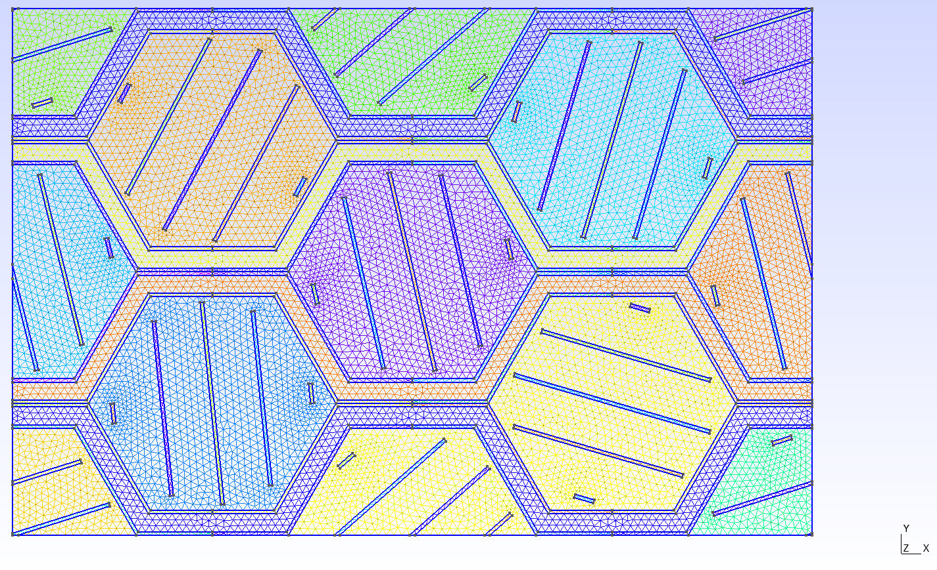
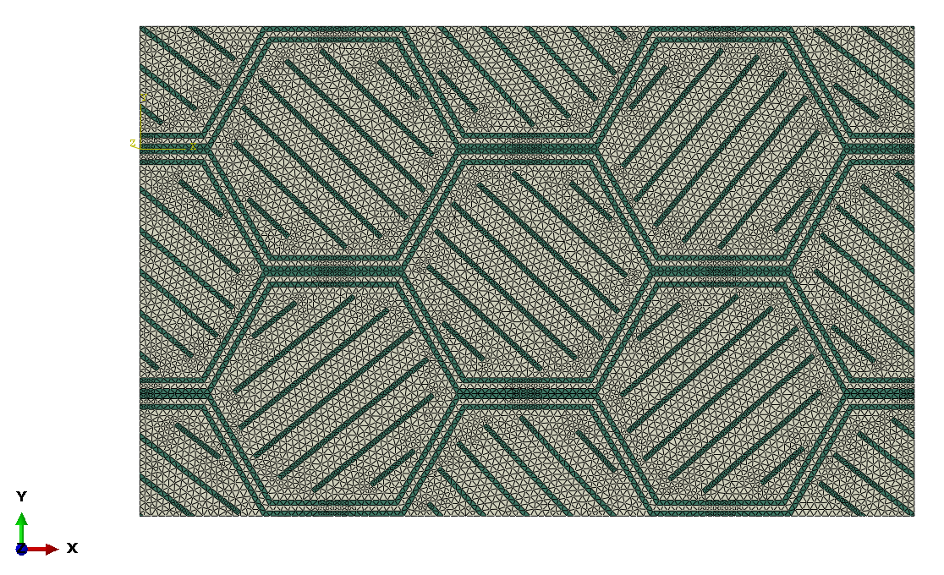
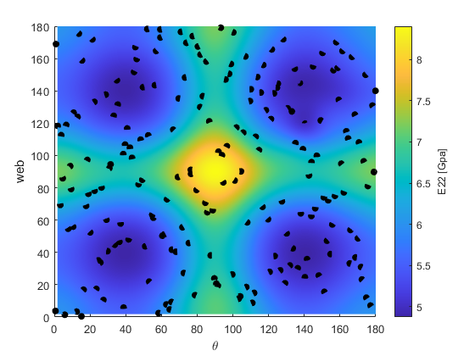
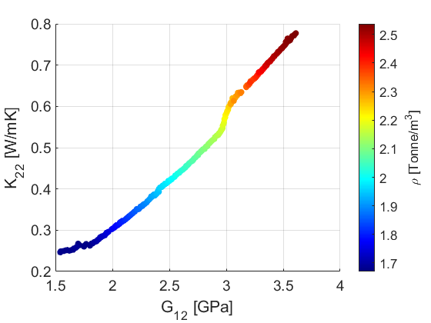
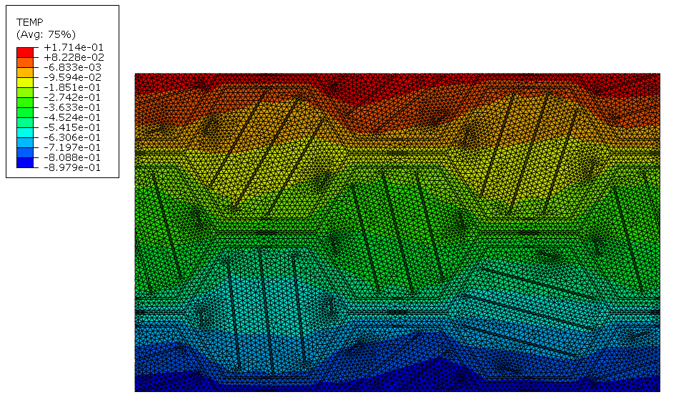
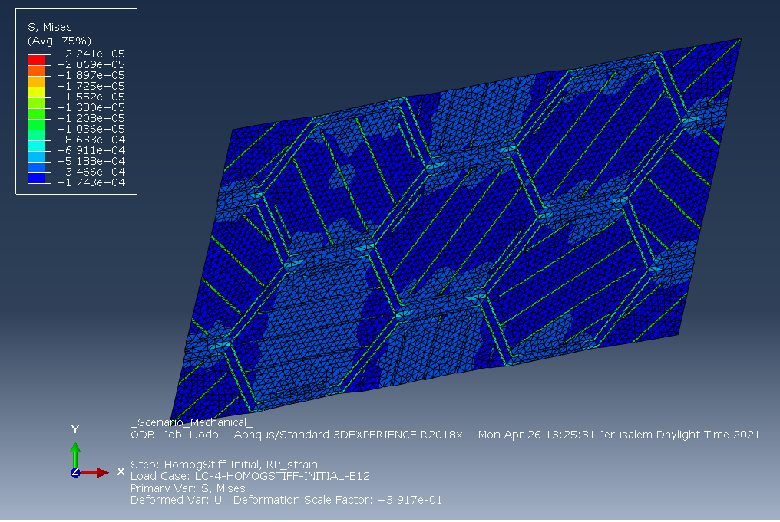
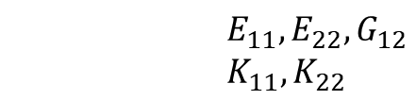
Method summery
DOE
Gmsh
PBC
Mechanical simulation
Thermal simulation
Effective properties
$$E_{11},E_{22},G_{12}$$
$$K_{11},K_{22}$$
RSM Model
Micromechanical
optimization

Slide 5
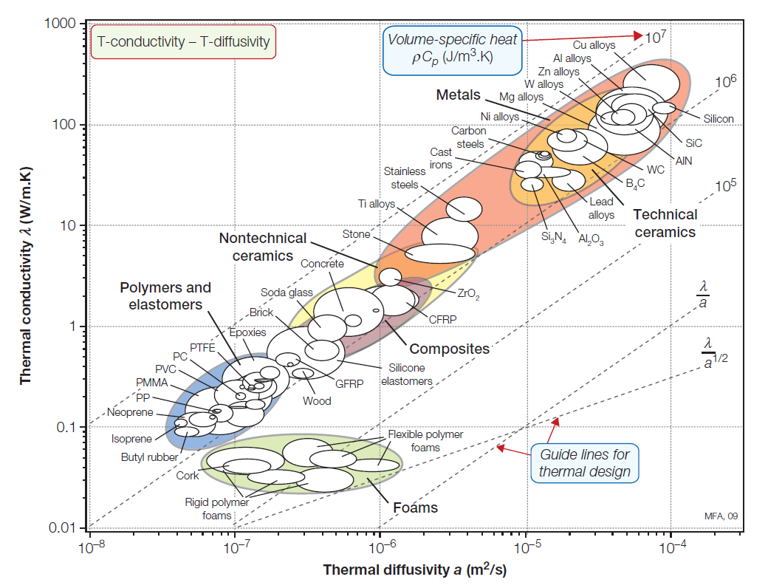
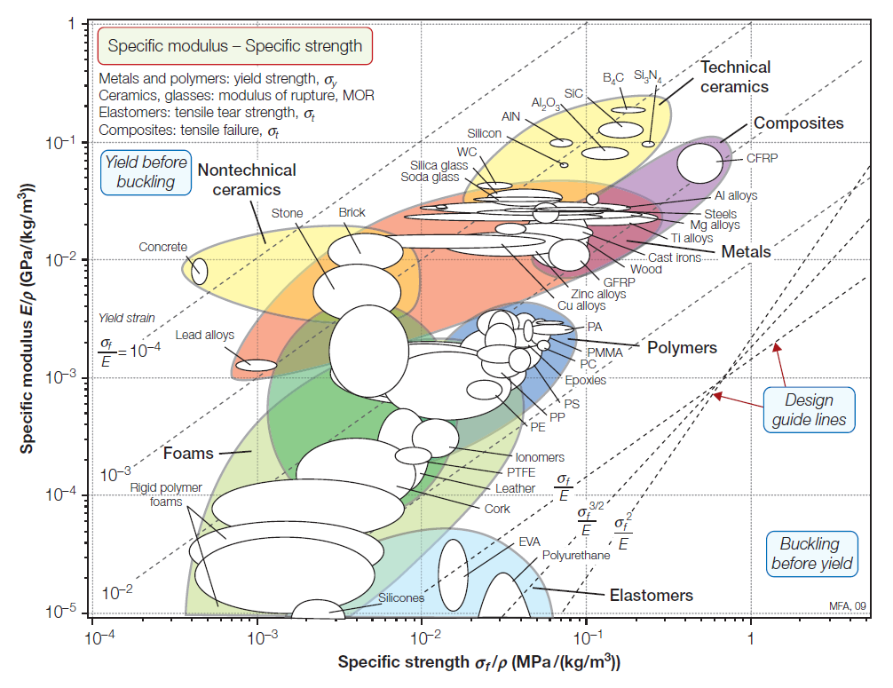


Material Selection
$$Goal$$
$$Goal$$

Slide 6
Material Selection
Name | Density | Modulus of elasticity | Failure strength | Elongation | Thermal Conductivity | Max service temp | Manufacturing
Ti-6av | 4.45 | 110 | 1170 | 10% | 7.1 | 900 | 3D,CNC
Glass | 2.5 | 70 | 40-250 | 4-5% | 0.2 | 400 | CNC?
Macor | 2.52 | 66.9 | 94 | 4-5% | 1.4 | 700 | CNC
Aluminum oxide | 3.9 | 350 | 460 | 0.1% | 30 | 1000 | ?
Zirconia | 5.6 | 200 | 330 | 0.2-0.3% | 3 | 500 | ?
Name | Density | Modulus of elasticity | Failure strength | Elongation | Thermal Conductivity | Max service temp | Manufacturing
Polyimide | 1.42 | 2.5 | 50-150 | 3% | 0.12 | 300 | Hot compression moulding
Cyanite ester | 1.2 | 2.9-4.3 | 50-150 | 5% | 0.2-0.4 | 350 | Casting
BMI | 1.2 | 3.5-4.5 | 50-150 | 4% | 0.3 | 250 | Casting

Slide 7
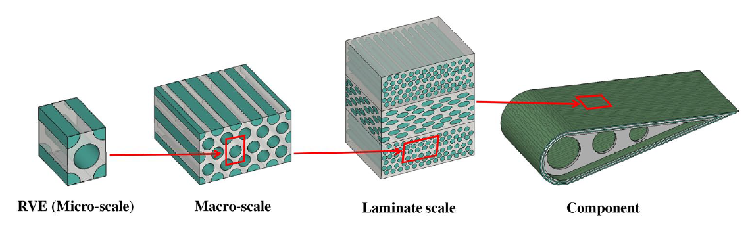
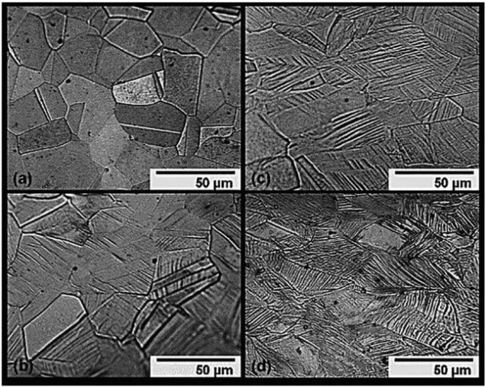
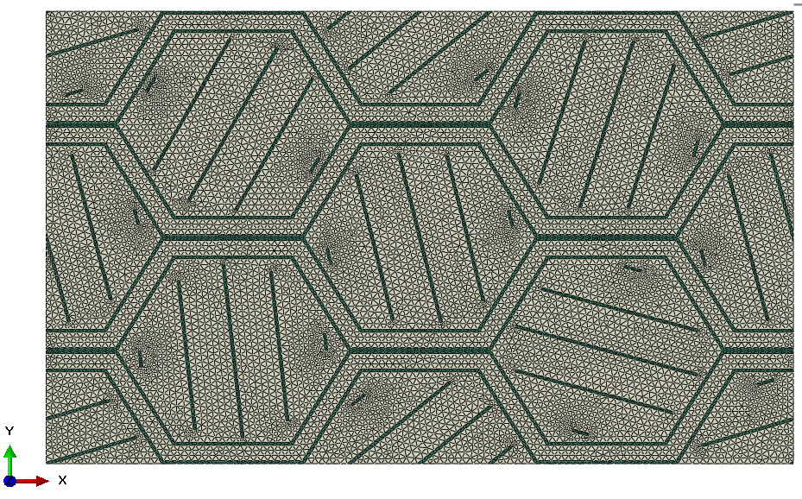
RVE

Slide 8
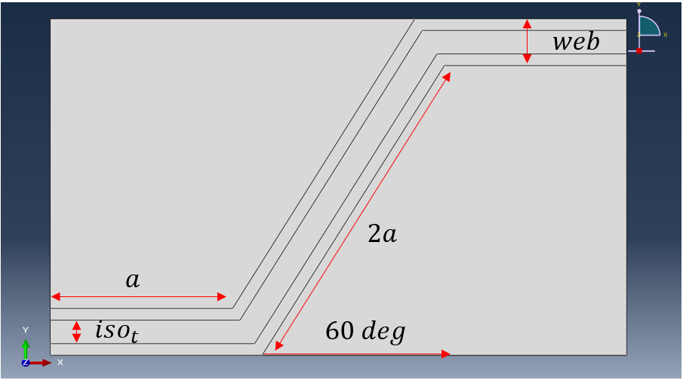
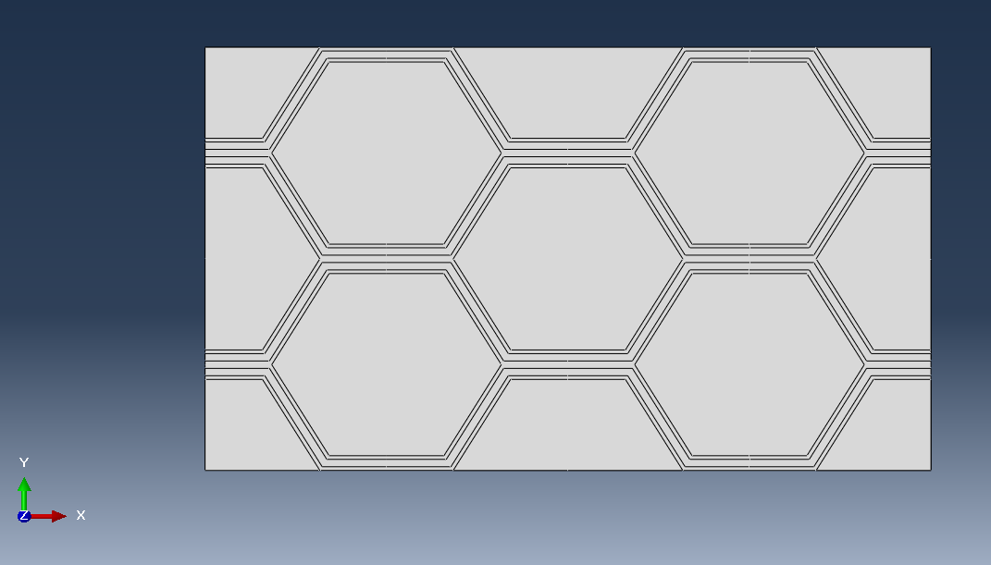
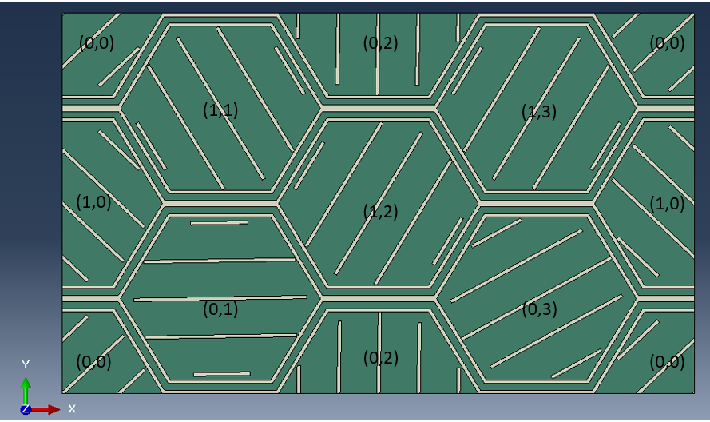
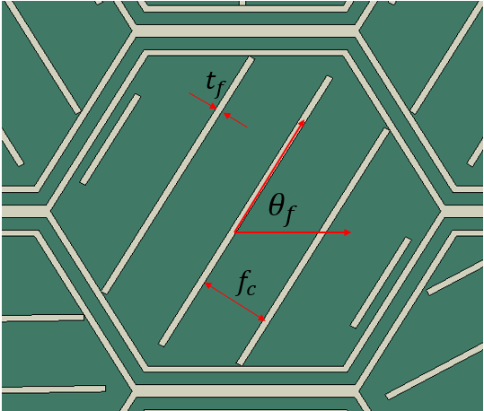
Geometry and design parameters

Slide 9
Periodic BC

Slide 10
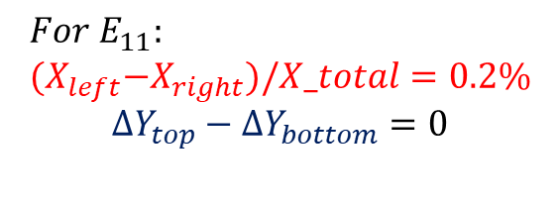
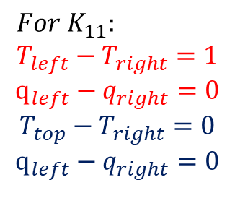
Meshing – creating a periodic mesh
$$For K_{11}: \\ T_{left}−T_{right}=1$$
$$q_{left}−q_{right}=0$$
$$T_{top}−T_{right}=0$$
$$q_{left}−q_{right}=0$$
$$For E_{11}: \\ {(X}_{left}−X_{right})/X_total=0.2\%$$
$${ΔY}_{top}−{ΔY}_{bottom}=0$$

Slide 11
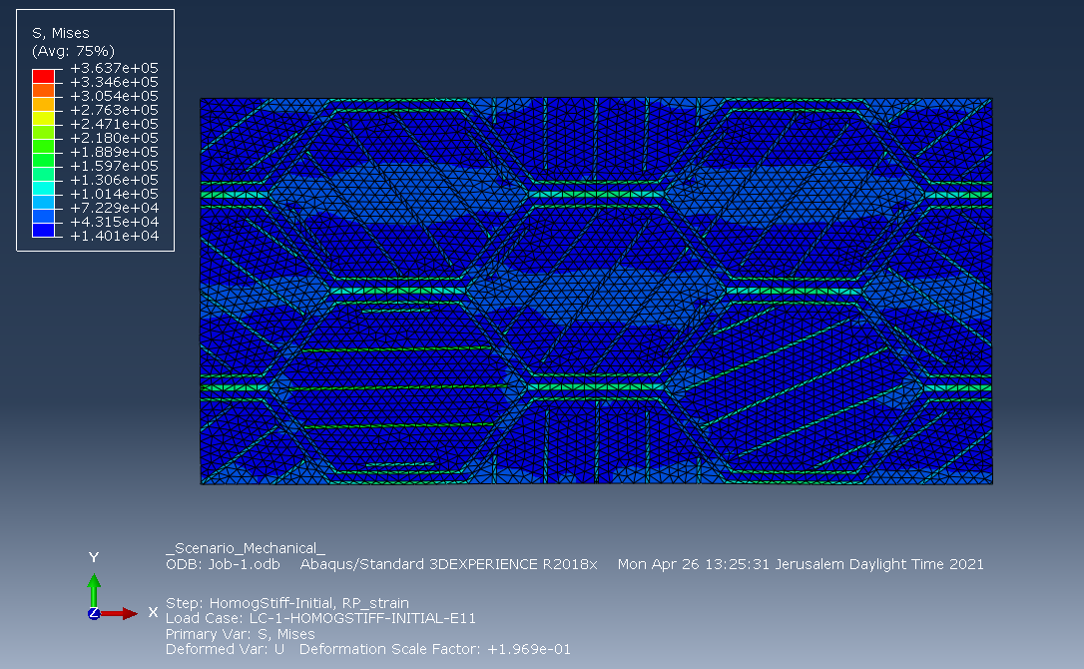
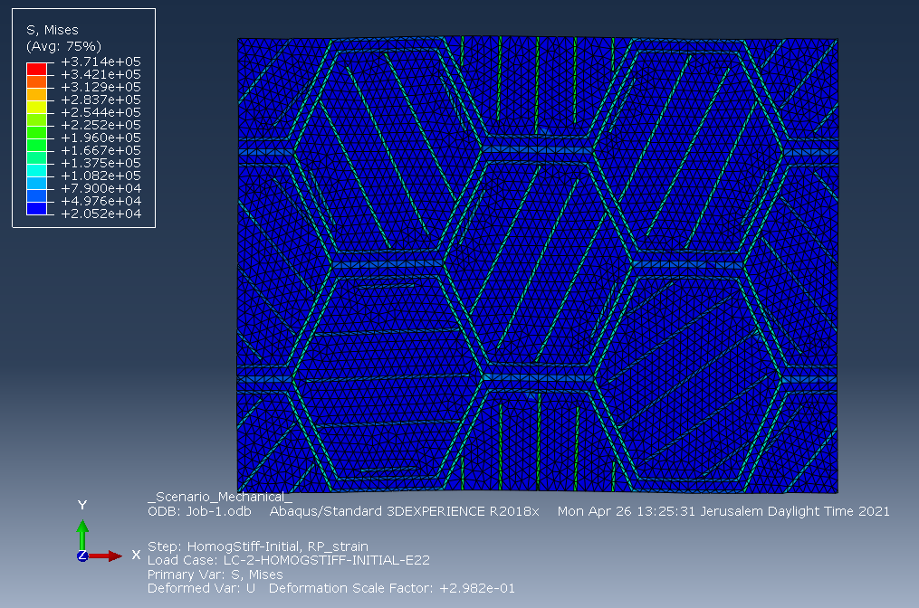
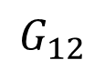
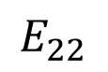
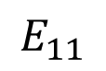
Mechanical Simulation
$$E_{11}$$
$$E_{22}$$
$$G_{12}$$

Slide 12
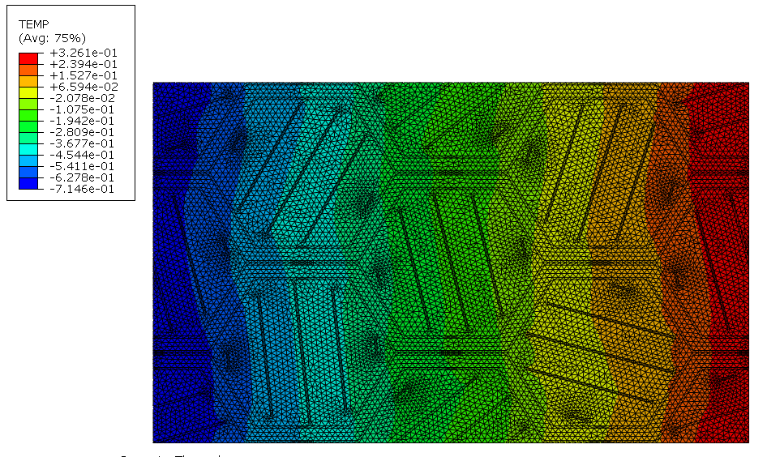
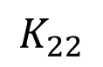
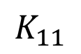
Thermal simulation
$$K_{11}$$
$$K_{22}$$

Slide 13
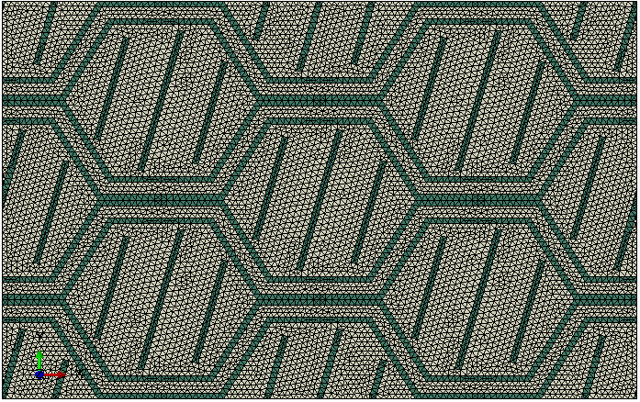
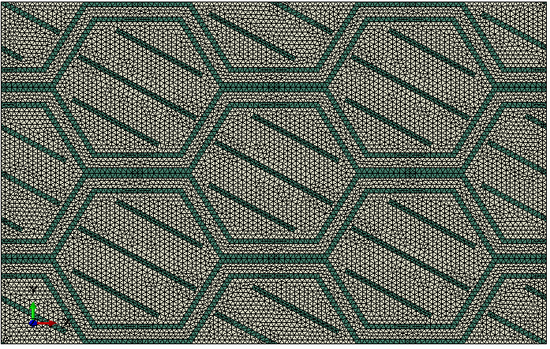
Design space-1 parameter

Slide 14
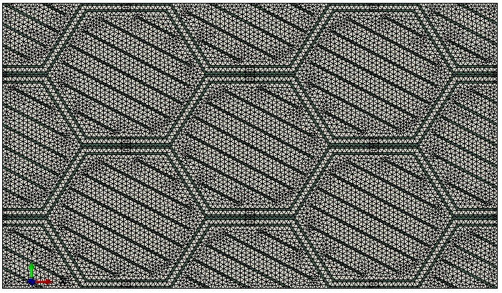
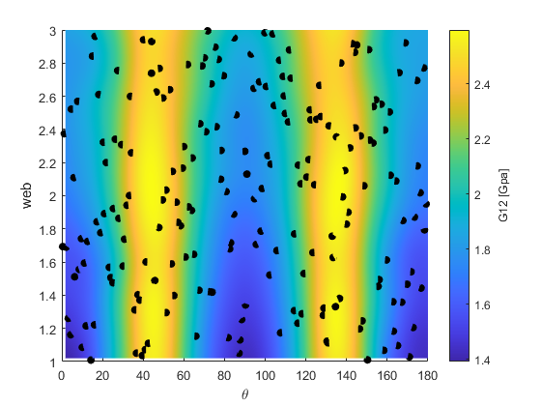
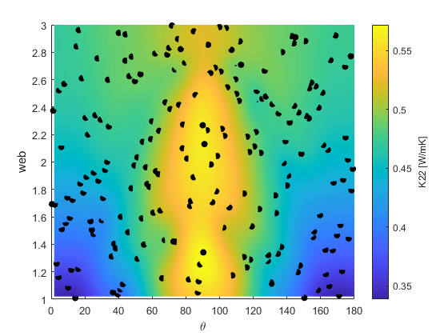
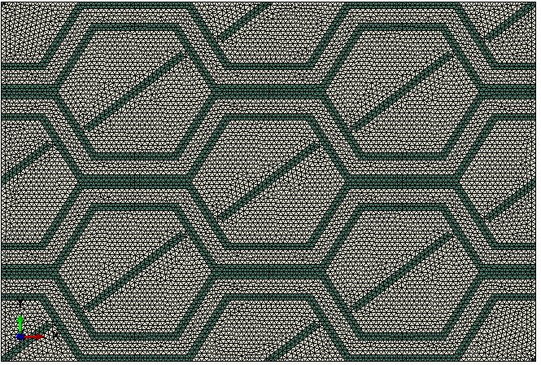
Design space-2 parameters

Slide 15
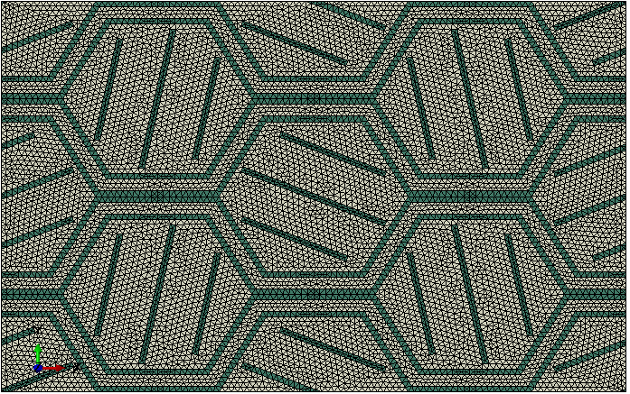
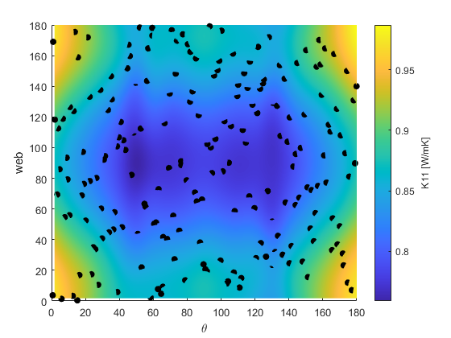
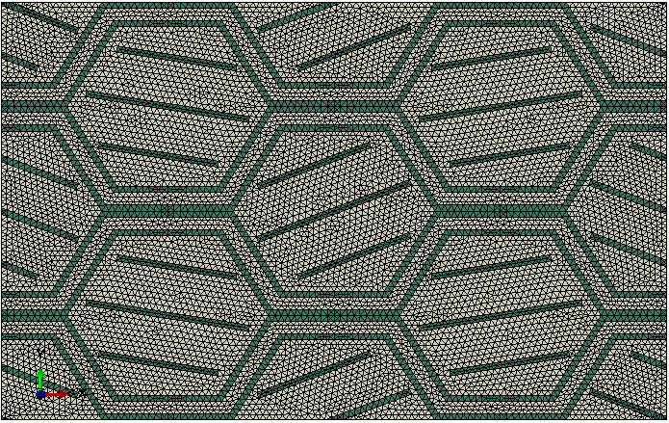
Design space-3 parameters

Slide 16
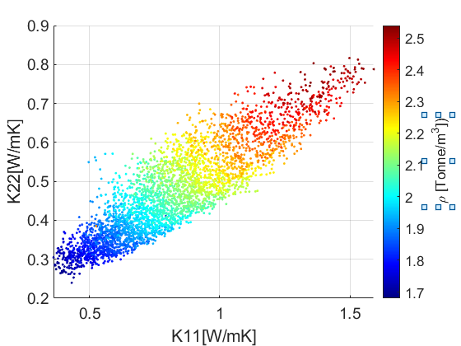
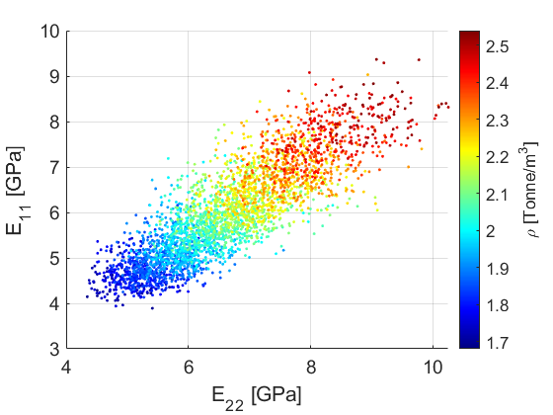
Design space-10 parameters

Slide 17
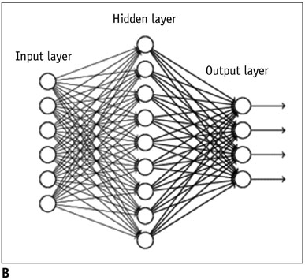
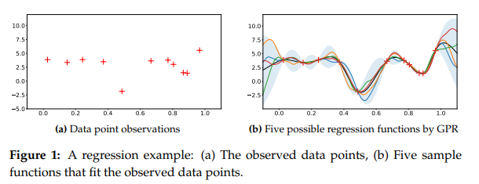
RSM model-GPR vs NN

Slide 18
RSM model-GPR vs NN
Regression Method | Rsq | RMSE | RUNTIME
GPR | 0.93 | 0.0495 | 900
NN | 0.91 | 0.0558 | 50

Slide 19
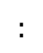
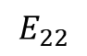
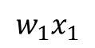
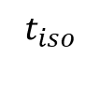
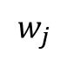
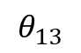
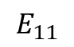
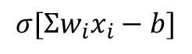
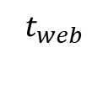
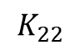
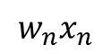












RSM model-NN
$$b_{i}$$
$$w_{i}$$
$$w_{j}$$
$$t_{web}$$
$$ρ$$
$$t_{iso}$$
$$E_{11}$$
$$θ_{00}$$
$$E_{22}$$
$$θ_{01}$$
$$G_{12}$$
$$:$$
$$K_{11}$$
$$θ_{12}$$
$$K_{22}$$
$$σ[Σw_{i}x_{i}−b]$$
$$θ_{13}$$
$$w_{1}x_{1}$$
$$Input layer$$
$$n=10$$
$$Hidden layer$$
$$n=50$$
$$Output layer$$
$$n=6$$
$$w_{2}x_{2}$$
$$w_{n}x_{n}$$

Slide 20


Objective Function
$$Attain Goals$$
$$Minimize Weight$$

Slide 21
Goal Optimization: case study
Goal-G12=2.21,K22=0.6,minimize weight
 | rho | E11 | E22 | G12 | K11 | K22 | Obj | Best Obj
predicted | 2.05 | 4.88 | 4.62 | 2.65 | 0.687 | 0.451 | -4.61 | -2.86
simulated | 2.07 | 5.10 | 4.69 | 2.90 | 0.70 | 0.45
Error
web | iso | Theta(0,0) | Theta(0,1) | Theta(0,2) | Theta(0,3) | Theta(1,0) | Theta(1,1) | Theta(1,2) | Theta(1,3)
1.02 | 0.358 | 142.3 | 38.7 | 133.2 | 40.7 | 140 | 136.65 | 137.6 | 49.6

Slide 22

Goal Optimization-sensitivity to objective parameters
$$α$$ | $$β$$ | $$γ$$ | $ρ$[Tonne/m^3] | $E_{11}$[GPa] | $E_{22}$[GPa] | $G_{12}$[GPa] | $K_{11}$[W/mk] | $K_{22}$[W/mk]
4 | 20 | 10 | 1.87 | 6.97 | 4.98 | 1.65 | 0.598 | 0.349
4 | 10 | 10 | 1.83 | 6.47 | 5.31 | 1.65 | 0.506 | 0.331
8 | 20 | 10 | 1.97 | 7.31 | 6.43 | 1.52 | 0.603 | 0.408

Slide 23








Optimization using NSGA II
6
5
1
4
Random Population
$${minimize f}_{2}$$
2
$$df_{2}$$
3
$$df_{1}$$
Fitness evaluation
$${minimize f}_{1}$$
6
6
5
Stopping criteria
5
1
1
4
4
$${minimize f}_{2}$$
2
No
New population
$${minimize f}_{2}$$
2
$$Pareto front$$
3
$$Pareto front$$
3
GA operators
G
Selection
$${minimize f}_{1}$$
Yes
$${minimize f}_{1}$$
Crossover
Mutation
Best Individual

Slide 24




Optimization using NSGA II
Generating random population
Assessing fitness value by frontiers
Assessing fitness using crowding distance

Slide 25

E11 VS K11 DEMONSTRATION

Slide 26





Optimization using NSGA II-Results

Slide 27






Slide 28





